Slide 1
DIP Paper Presentation SLIC Superpixels Compared to State-of-the-Art Superpixel Methods Radhakrishna Achanta, Member, IEEE, Appu Shaji, Kevin Smith, Member, IEEE, Aurelien Lucchi, Pascal Fua, Fellow IEEE, and Sabine Süsstrunk, Senior Member, IEEE IEEE TRANSACTIONS ON PATTERN ANALYSIS AND MACHINE INTELLIGENCE, VOL. 34, NO. 11, NOVEMBER 2012
Presented By-
Deeksha Aggarwal
MS2019006

Slide 2
Contents
Objective of the paper
Introduction to superpixels
Existing Superpixel Methods
Implementation of Existing Superpixel Methods
Properties of Good Superpixel
SLIC Algorithm
Observation of SLIC segmentation by tuning its parameters.
Comparison of SLIC with state of the art superpixel methods
Summary and Inferences
Limitation of the proposed work
Possible methods to overcome the limitations
Implementation of possible methods to overcome the limitations

Slide 3
Objectives:
To introduce a new superpixel algorithm, simple linear iterative clustering (SLIC), which adapts a k-means clustering approach to efficiently generate superpixels.
To compare SLIC with the state-of-the-art superpixel algorithms the paper has discussed the following parameters:
Ability to adhere to image boundaries,
speed,
memory efficiency,
segmentation performance.

Slide 4
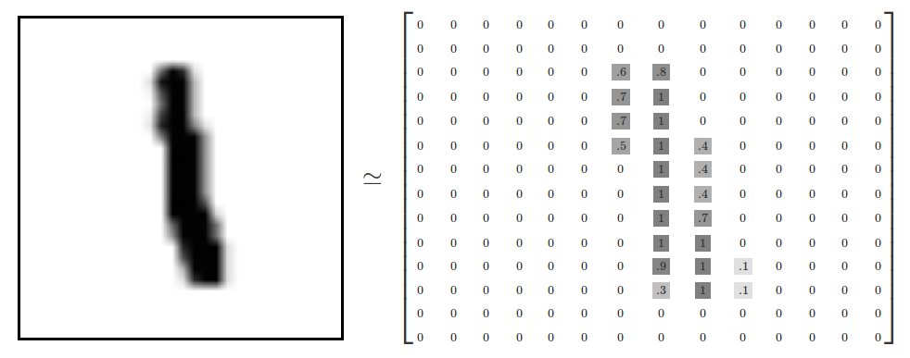
Superpixels
A superpixel can be defined as a group of pixels which have similar characteristics. It is generally color based segmentation. Superpixels can be very helpful in image segmentation.
Superpixel 1
Superpixel 2
(Rest of the image)
Notes:
If one needs to compute a property that stays approximately constant for an object, then superpixel representation is more efficient
Instead of exhaustive examining of all rectangular patches [10], an alternative is to examine only superpixels

Slide 5
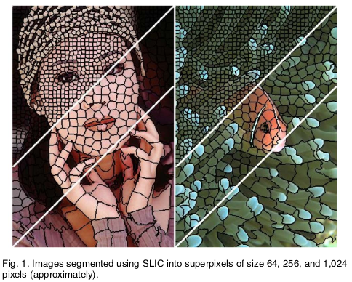
Motivation:
Advantages of Superpixels
Computationally efficient.
Efficient Preprocessing step to many image segmentation algorithm.
Reduction in the number of hypothesis.
Some algorithms provide control over the amount of superpixels and their compactness or shape which helps in efficient/similar superpixel formation.
Source: SLIC Superpixels Compared to State-of-the-Art Superpixel Methods

Slide 6
Existing Superpixel Methods:
Graph Based Algorithms
Gradient Ascent Based Algorithms

Slide 7
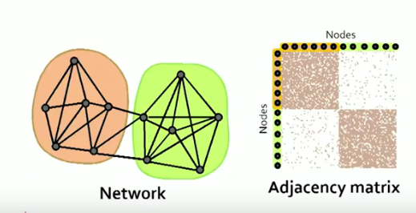
Existing Superpixel Methods:
Graph Based Algorithms
Pixel/Node
Treat each pixel as a node in a graph.
Adjacency Matrix- Edge weights between two nodes are proportional to the similarity between neighboring pixels.
Superpixels are created by minimizing a cost function defined over the graph.
Examples:
Normalized cuts
Graph Based Segmentation
Graph Cut
1= if two nodes are connectected
0= Otherwise

Slide 8
Existing Superpixel Methods:
Gradient Ascent Based Algorithms
Starting from a rough initial clustering of pixels, gradient ascent methods iteratively refine the clusters until some convergence criterion is met to form superpixels.
Quick Shift
Mean Shift
Watershed Segmentation
Turbopixel Method
K- Means Clustering
SLIC

Slide 9
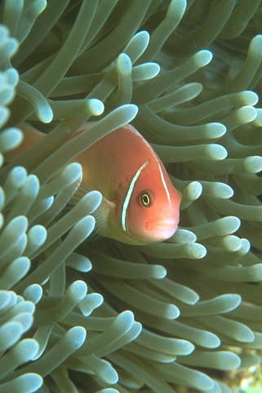
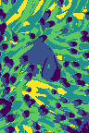
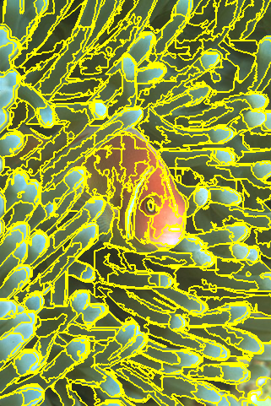
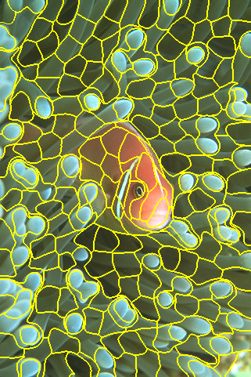
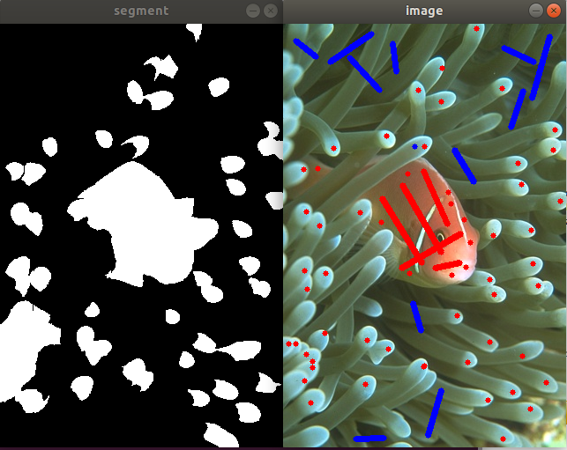
Implementation of existing superpixel pixel algorithms
Original
Normal Cut
Graph Segmentation
Graph Cut
SLIC
Amount of superpixels control | YES | NO | YES | YES
Compactness Factor | NO | NO | NO | YES

Slide 10
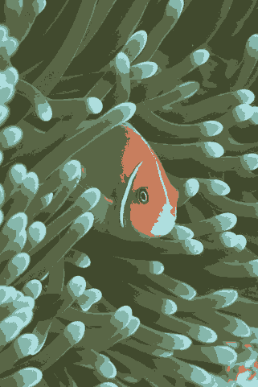
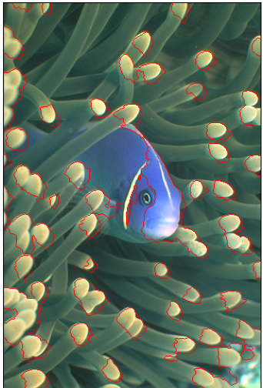
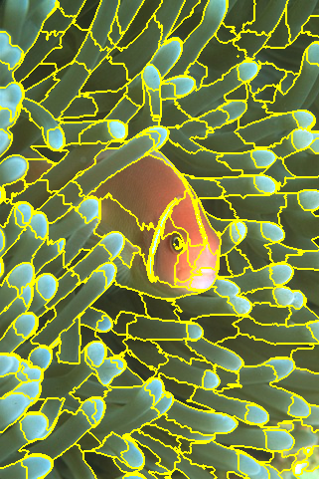
Implementation of existing superpixel pixel algorithms
Original
K-Means
Clustering
Watershed Algorithm
Quick Shift
SLIC
Amount of superpixels control | YES | NO | NO | YES
Compactness Factor | NO | NO | NO | YES

Slide 11
Properties of a Good SuperPixel?
Faster formation.
Memory efficient.
Exhibits boundary adherence.
Should offer control over the amount of superpixels and its compactness.
Should Captures global aspects of the image.
Segmentation accuracy and speed.
SLIC has All these properties!

Slide 12
Proposed Work:
Simple Linear Iterative Clustering
(SLIC)

Slide 13
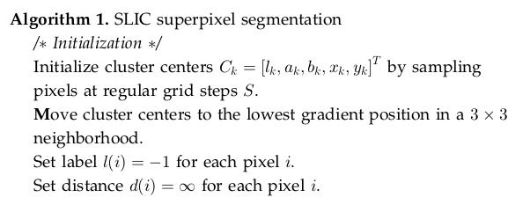
Algorithm:
Notes:
Distance in RGB space between 2 pixels (kmeans only use this param that too on each pixel)
Distance in x-y space between 2 pixels (addition param in slic)
This is done to avoid centering a superpixel on an edge and to reduce the chance of seeding a superpixel with a noisy pixel.

Slide 14
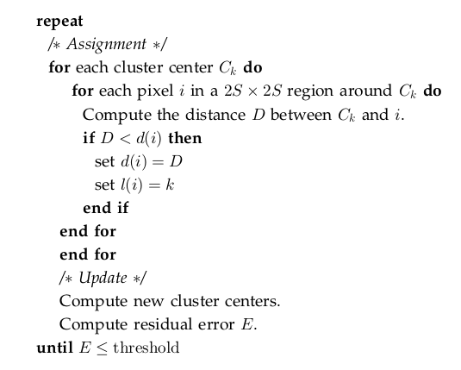
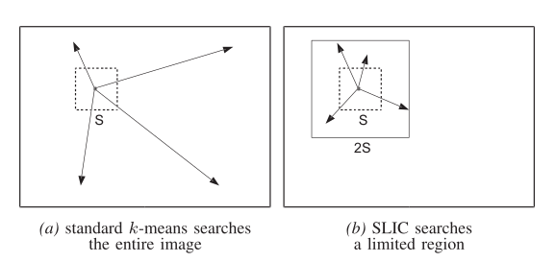
Algorithm:
Notes:
Distance in RGB space between 2 pixels (kmeans only use this param that too on each pixel)
Distance in x-y space between 2 pixels (addition param in slic)
This is done to avoid centering a superpixel on an edge and to reduce the chance of seeding a superpixel with a noisy pixel.

Slide 15
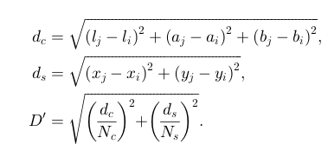
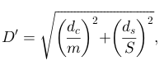
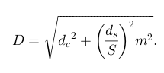
Distance Metric:
To combine the two distances into a single measure, it is necessary to normalize color proximity and spatial proximity by their respective maximum distances within a cluster, N_{s} and N_{c} .
N_{s} = S = √N/k
N_{c} = m , [1, 40] compactness parameter
Notes:
Distance in RGB space between 2 pixels (kmeans only use this param that too on each pixel)
Distance in x-y space between 2 pixels (addition param in slic)
This is done to avoid centering a superpixel on an edge and to reduce the chance of seeding a superpixel with a noisy pixel.

Slide 16
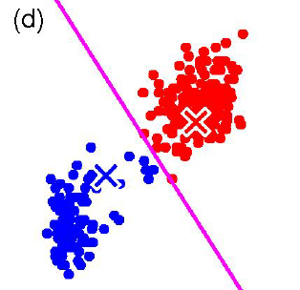
Parameters of SLIC ALgorithm:
K or Number of Labels in the segmented output
M or compactness factor. It balances color and space proximity. Higher values give more weight to space proximity, making superpixel shapes more square/cubic.
Threshold: Maximum number of iterations to loop.
Once each pixel has been associated to the nearest cluster center, the L 2 norm is used to compute a residual error E between the new cluster center locations and previous cluster center locations. The assignment and update steps can be repeated iteratively until the error converges.
Error Measure or stopping Criteria:

Slide 17
Inferences:
In SLIC the local regions with similar color and texture distributions are part of the same superpixel group.
Both Spatial and color proximity are taken into account while assigning the labels to each pixel. This can be controlled by compactness parameter.
SLIC do not compute distances between each pixel but this calculation of distance is limited to a window of 2S where S is √N/k.
Point number 2 and 3 are not present in kmeans if we compare the SLIC algorithm with kmeans clustering algorithm.

Slide 18
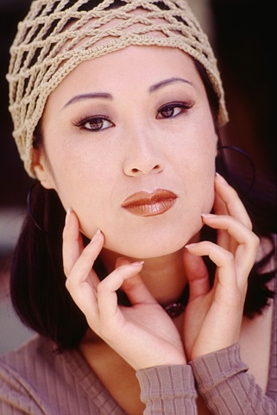
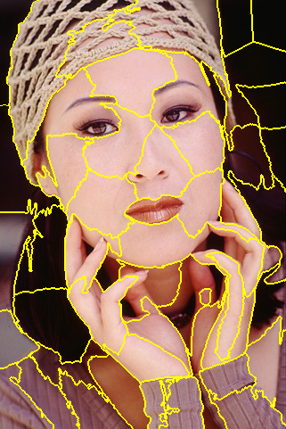
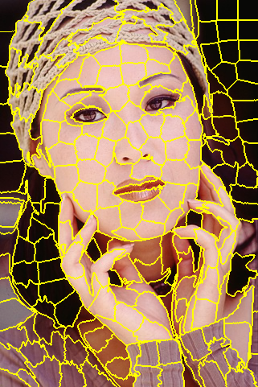
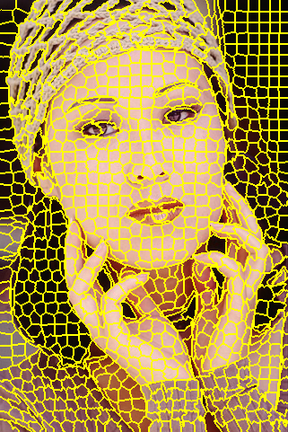
Results: SLIC (Tuning No. of Labels (K))
Original
K=64
Under segmentation. Unable to capture intensity change in small regions..
K=256
Good Segmentation. Able to capture intensity change in small regions.
k=1024
Oversegmentation

Slide 19
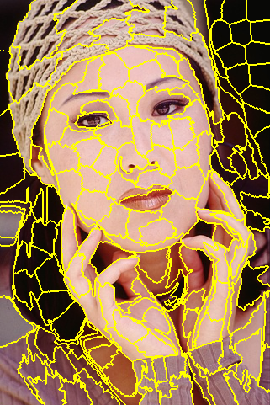
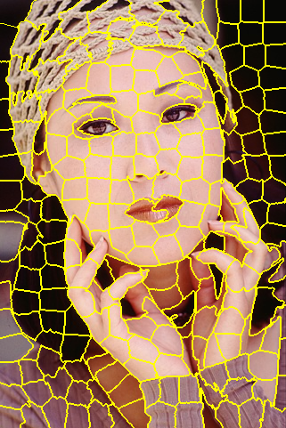
Results: SLIC (Tuning Compactness (m)), K=256
Original
m=5
Irregular in shape. More importance is given to color proximity.
m=10
Combination of both irregular and regular superpixels.
m=20
Superpixels are more compact/rectangular and more importance is given to space proximity
Color proximity > spatial proximity
Boundary Adhrence Increases

Slide 20
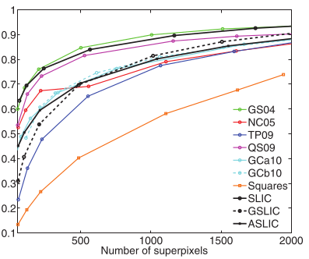
Results: Segmentation Performance
Results Given in the paper

Slide 21
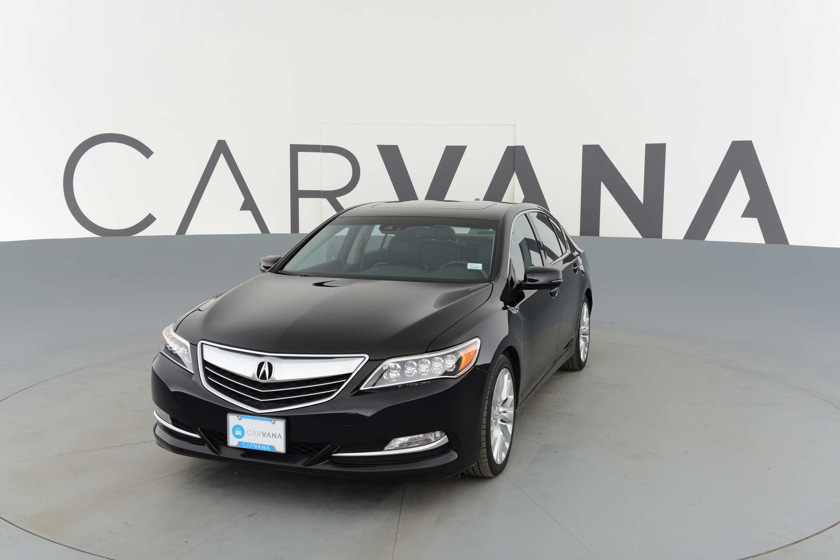
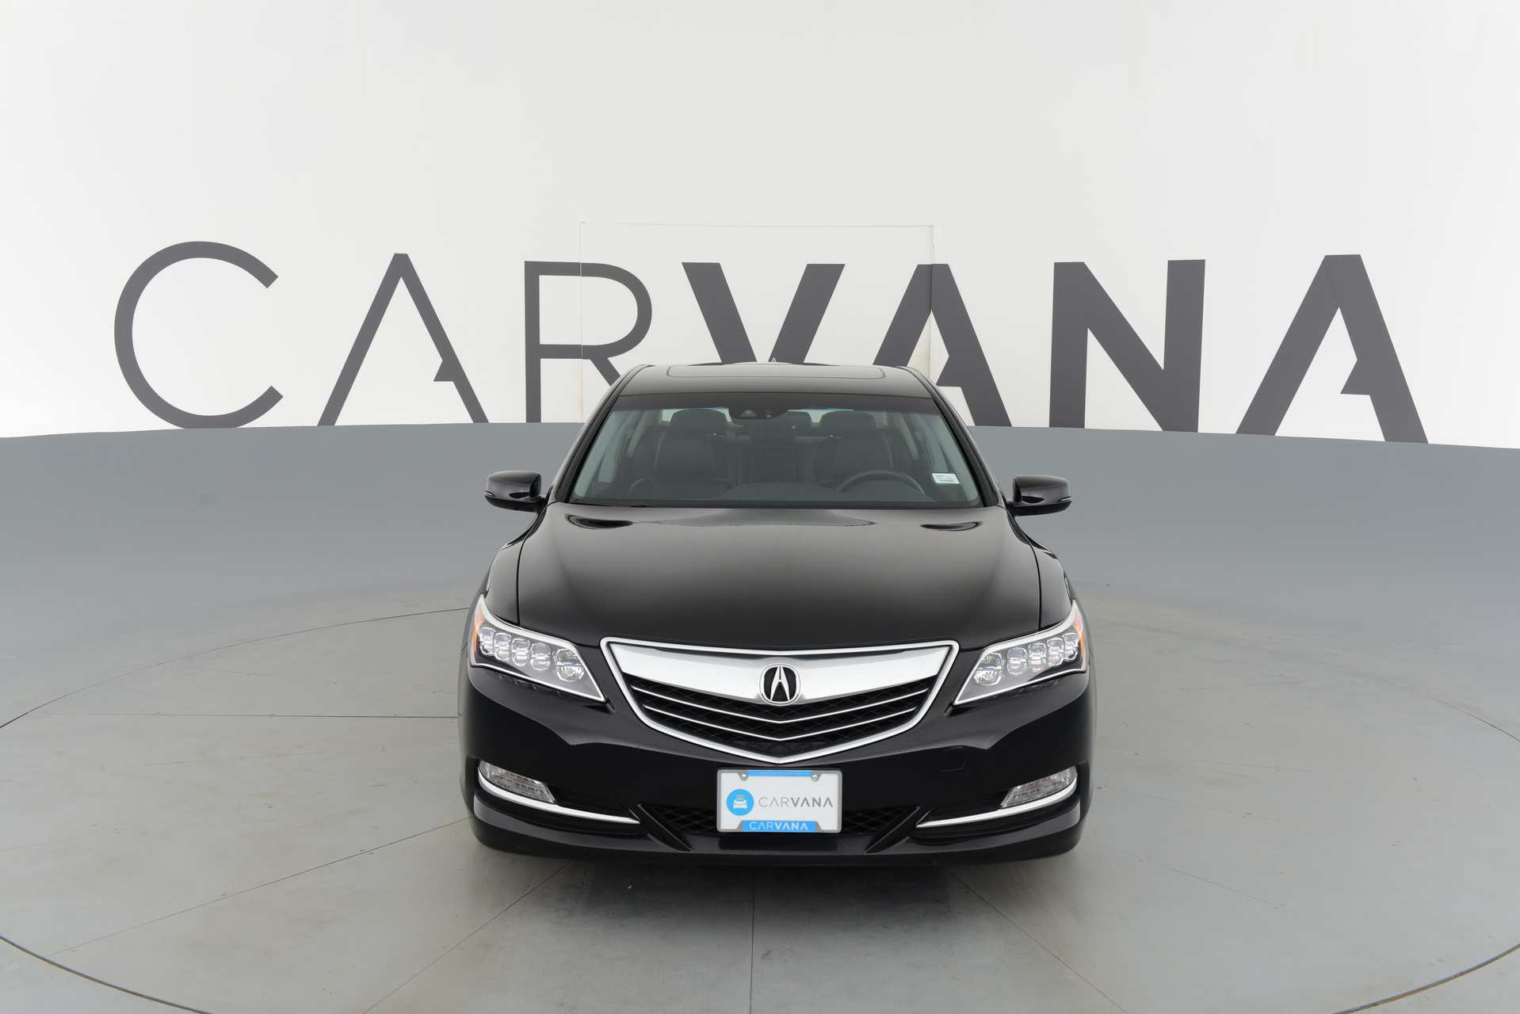
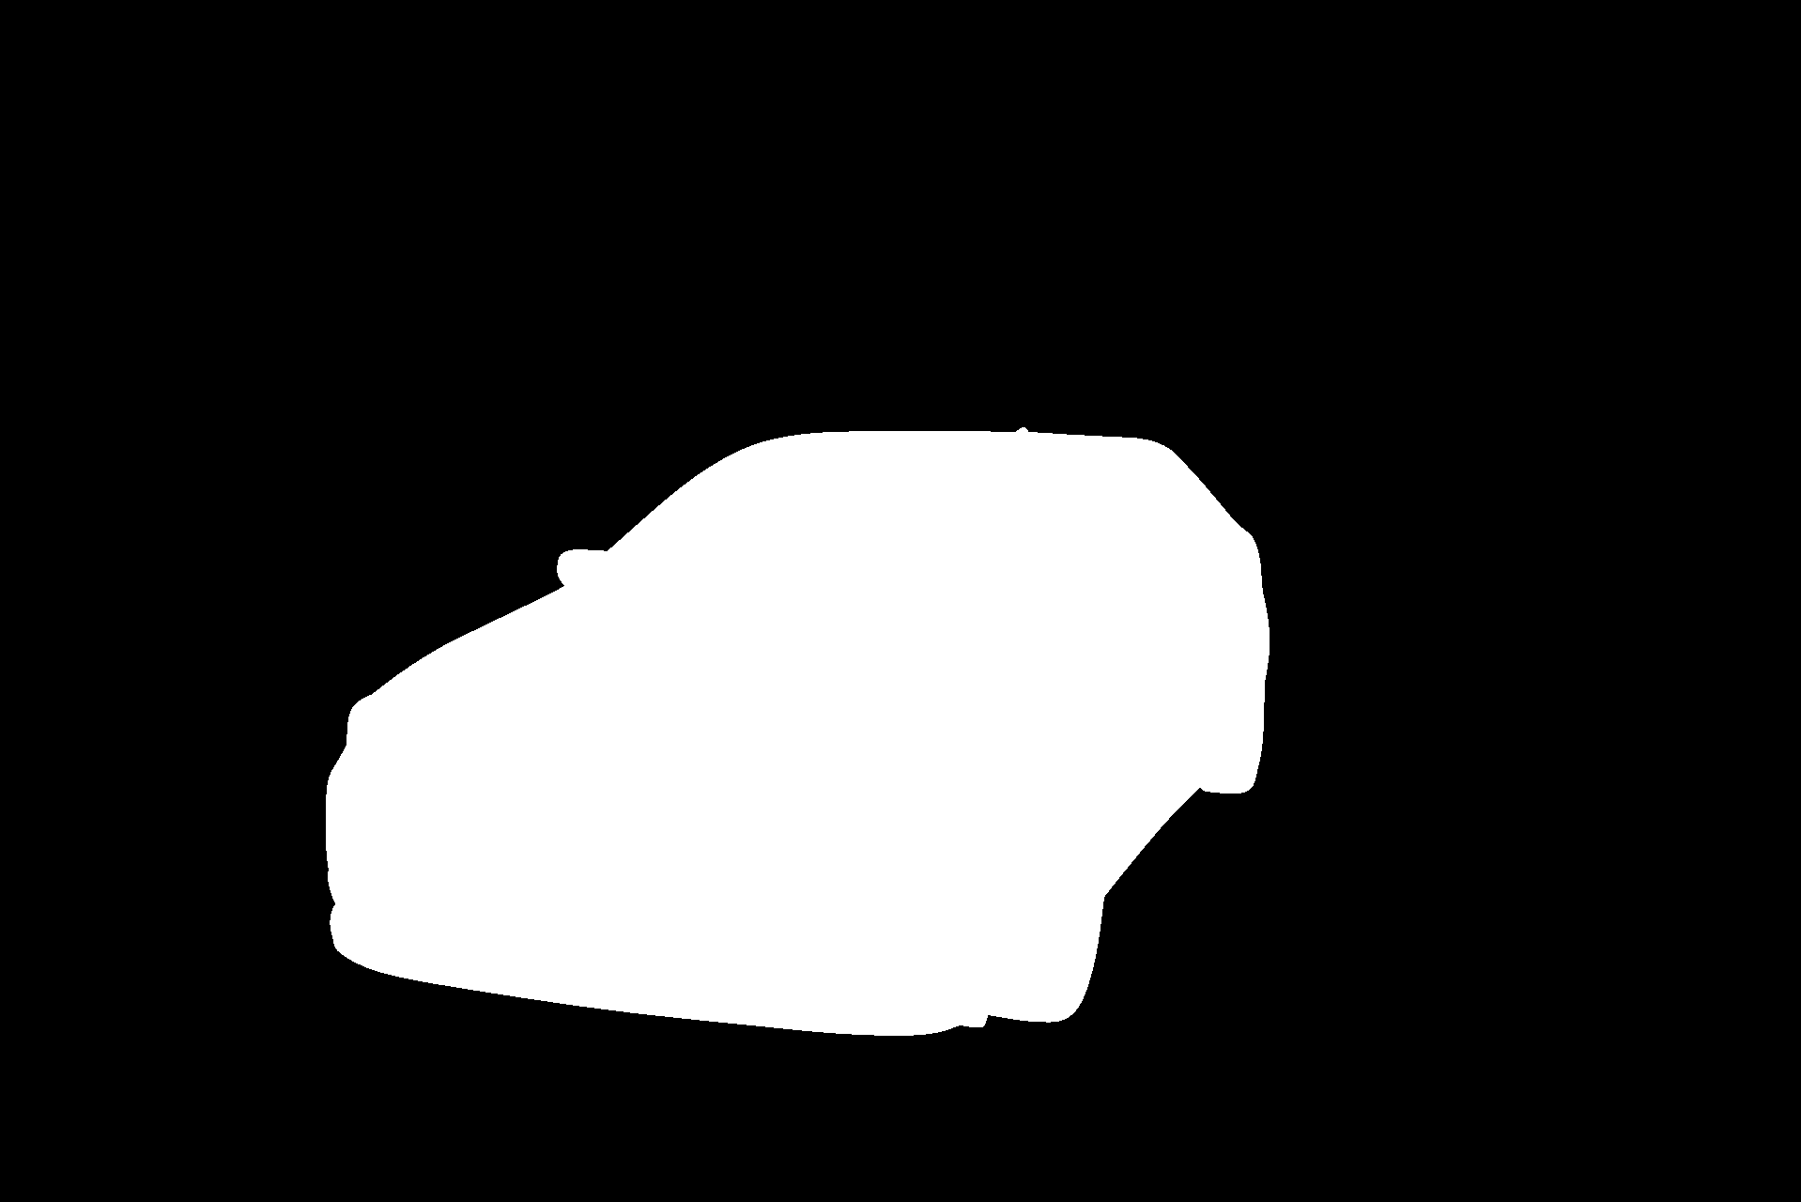
Segmentation Performance with ML algorithm:
Aim: To compare the generalization of segmentation error for three input images:
Original image
Slic segmentation
Felzenszwalb segmentation
Input Train Image
Input Labels
(mask Image)
Input Test Image
YCbCr
ML MODEL
(Random Forest)
Training and Validation Accuracy
Feature Importance
LAB
Gaussian
32 Gabors
lbp
canny
sobel
Feature Extraction
Inference
(on Test Image)

Slide 22
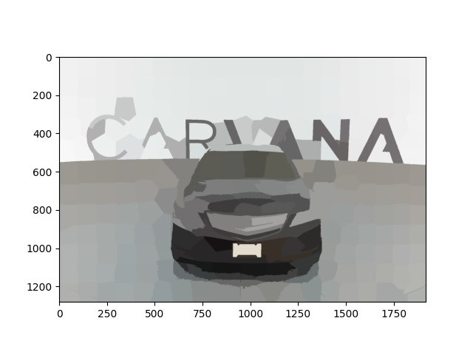
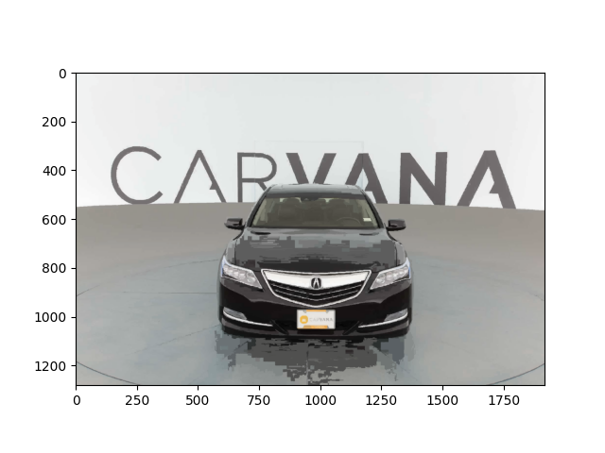
Comparison on Training and Validation Accuracy:
Original
Slic Segmentation
Felzenszwalb Segmentation
Training Accuracy | 0.999 | 0.999 | 1.0
Validation Accuracy | 0.988 | 0.991 | 0.990

Slide 23

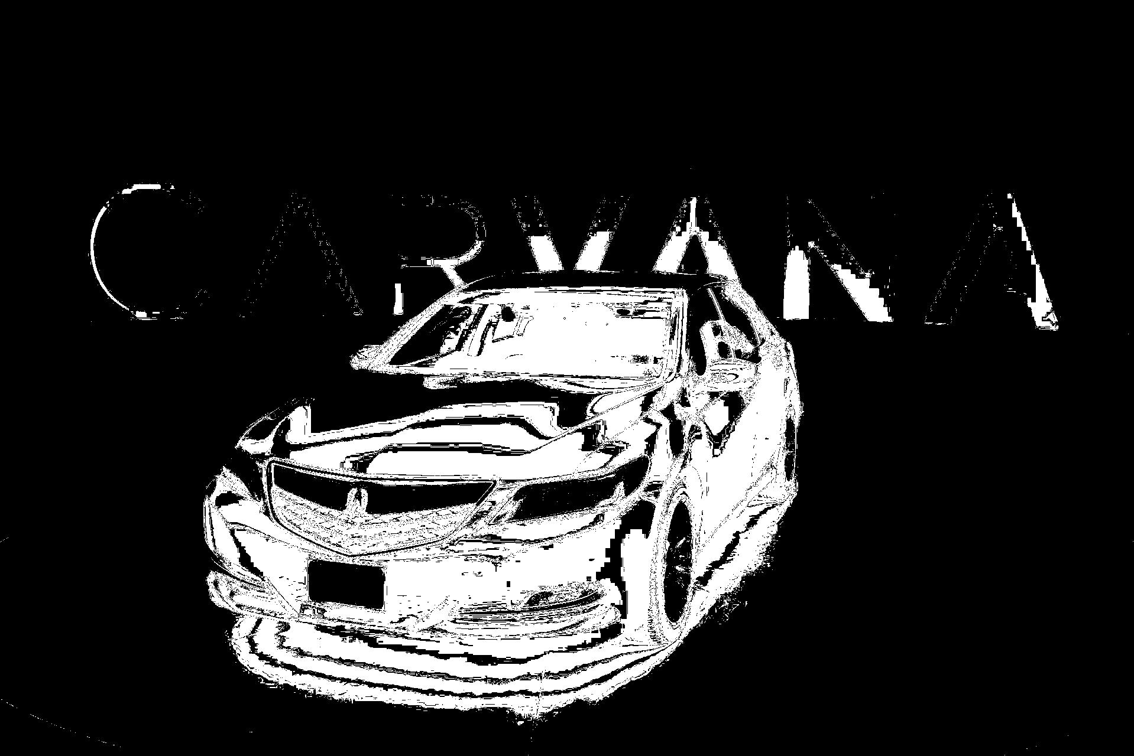
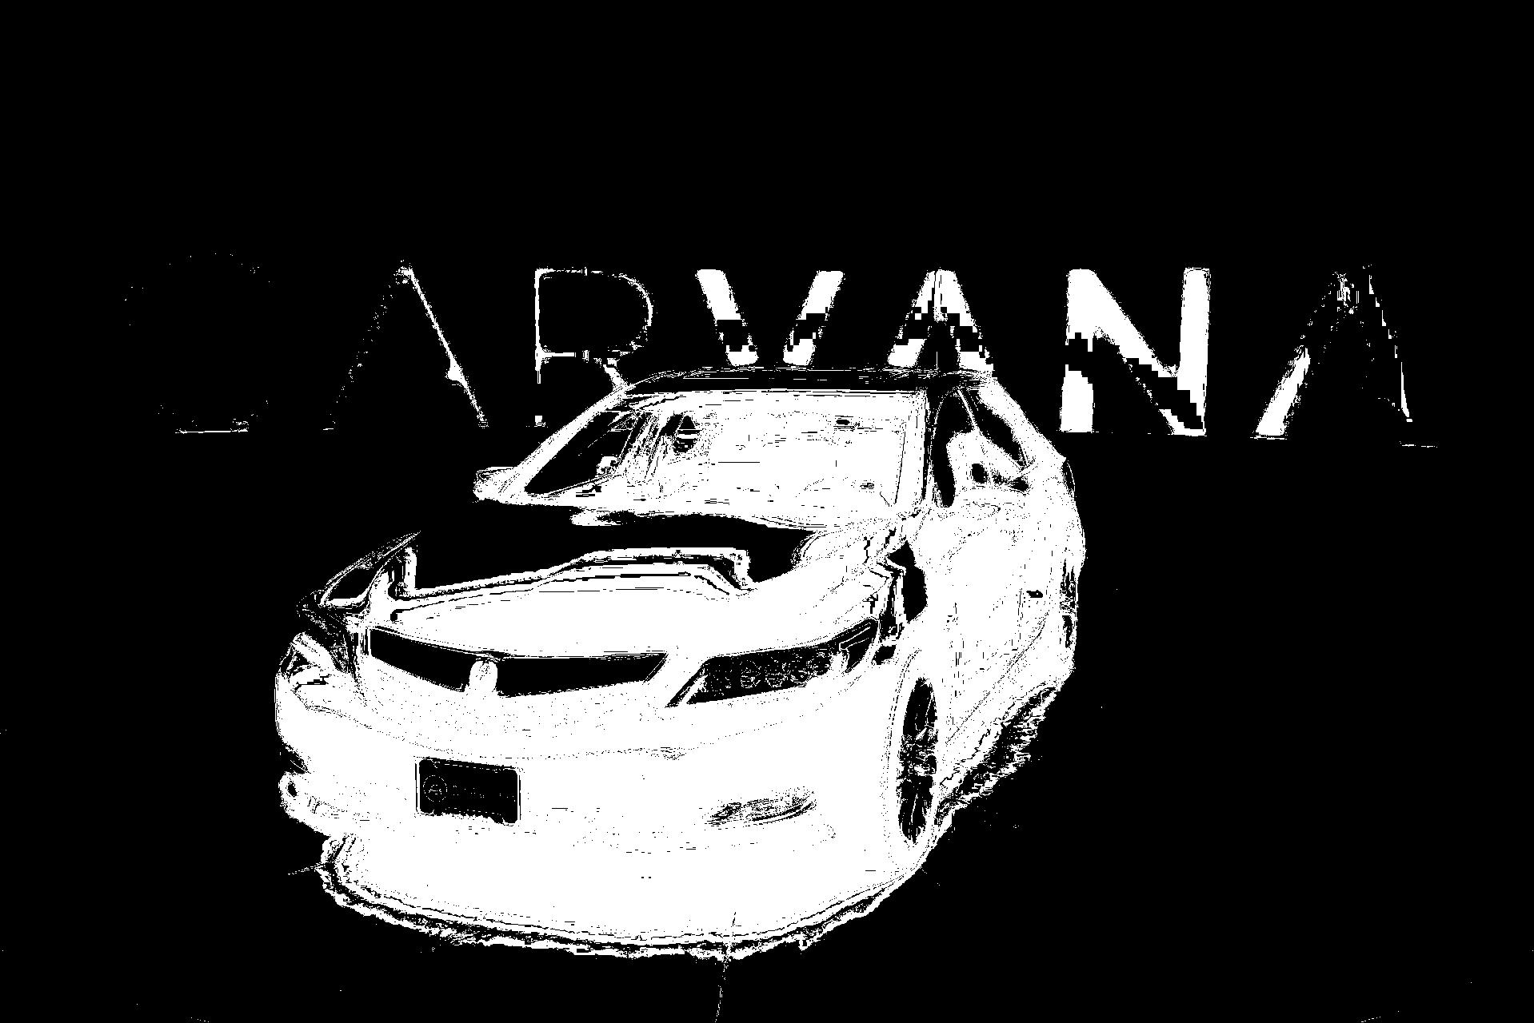
Comparison on Testing Accuracy:
Original Test Image
Masked Test Image
Original Segmentation
Slic Segmentation
Felzenszwalb Segmentation
Accuracy | 0.312 | 0.281 | 0.304
IOU | 0.533 | 0.530 | 0.607

Slide 24
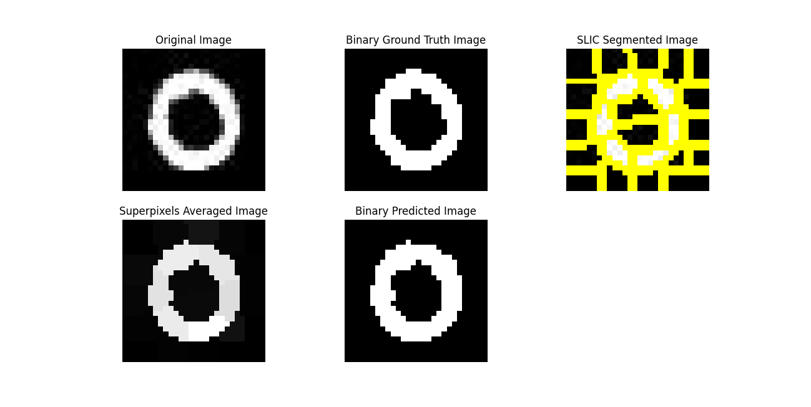
SLIC Results without ML: MNIST Gray Image
Results Evaluation:
IOU(0) = 0.9754
IOU(255) =0.920
Num segments=19,
Compactness= 1.0

Slide 25
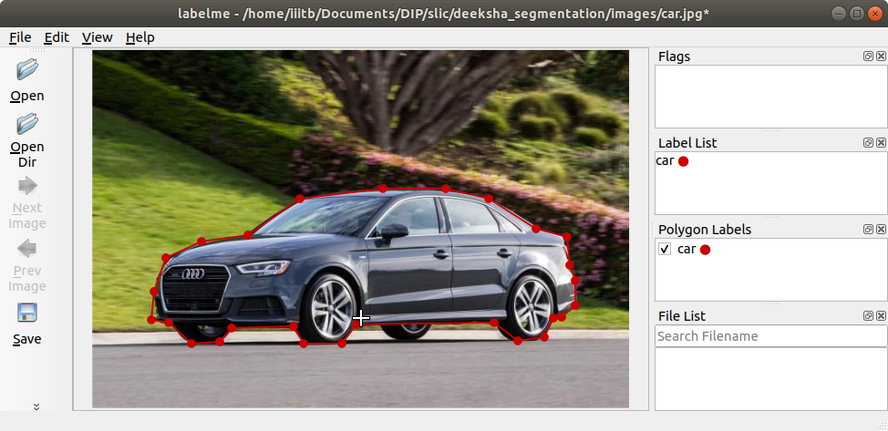
Results: RGB Image Labeling:

Slide 26
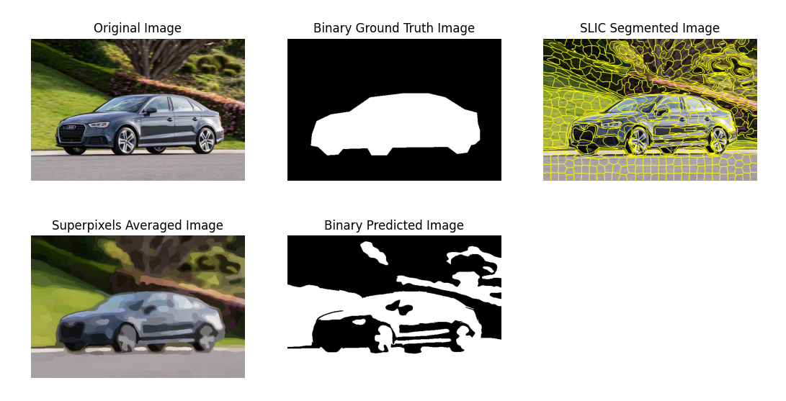
SLIC Results without ML: RGB Image
Results Evaluation:
IOU(0) = 0.446
IOU(255) = 0.233
Num segments=512,
Compactness= 5.0
Sigma = 5

Slide 27
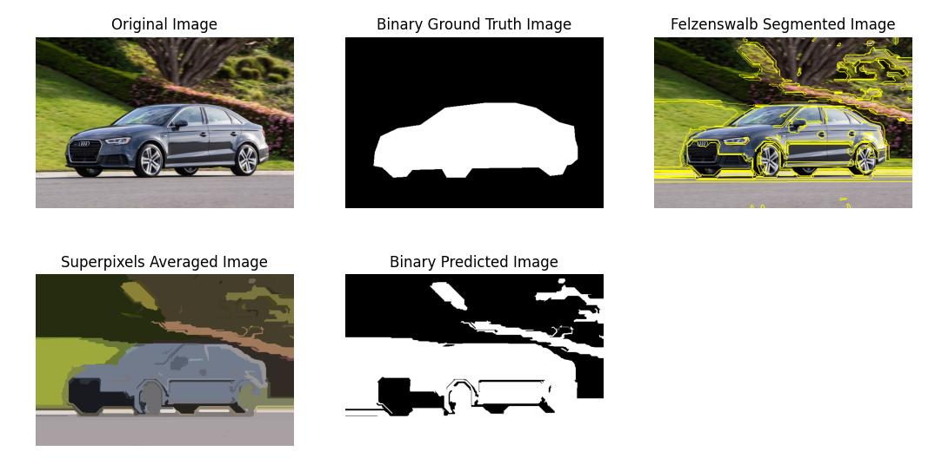
Felzenszwalb Graph Segmentation Results: RGB Image
Results Evaluation:
IOU(0) = 0.4820
IOU(255) = 0.3296
K = N.A
Compactness= N.A
Results Evaluation:
IOU(0) = 0.4463
IOU(255) = 0.2239
K = 30
Compactness= N.A

Slide 28
Results: Computational and Memory Efficiency

Slide 29
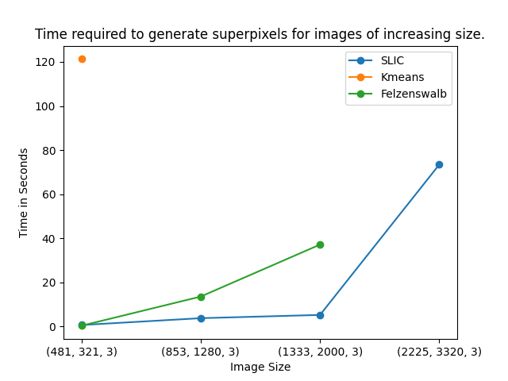
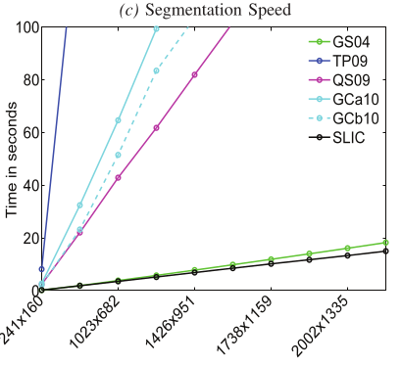
Computational and Memory Efficiency
K=256
My Results
Results given in the paper

Slide 30
Possible Limitation of SLIC
SLIC uses fixed search region of 2SX2S to reduce computation complexity, but what about the boundary pixels.
Solution: Region growing segmentation algorithm
The assignment and update steps are performed separately which can lead to low convergence rate because separately performing the assignment step and the update step also leads to a delayed feedback of pixel label change.
Solution: Dynamic seeding/assigning the labels as it gets updated.
Hard Clustering which means each pixel belongs to either one of the clusters.
Solution: Soft clustering algorithms such as GMM.

Slide 31


Implementation Possible Solutions of SLIC
Probabilistic clustering algorithms or soft clustering techniques in which each pixel is belongs to every cluster with a certain probability. In this way the clustering updates are done by expectation maximization algorithm.
Solution: Gaussian Mixture Model
Implementation:
Original Test Image
Masked Test Image
GMM Segmentation
(Without ML)
GMM Segmentation
(With ML)
Accuracy - 0.243
IOU - 0.457
Accuracy - 0.35
IOU - 0.64

Slide 32
Thank You

